Slide 1

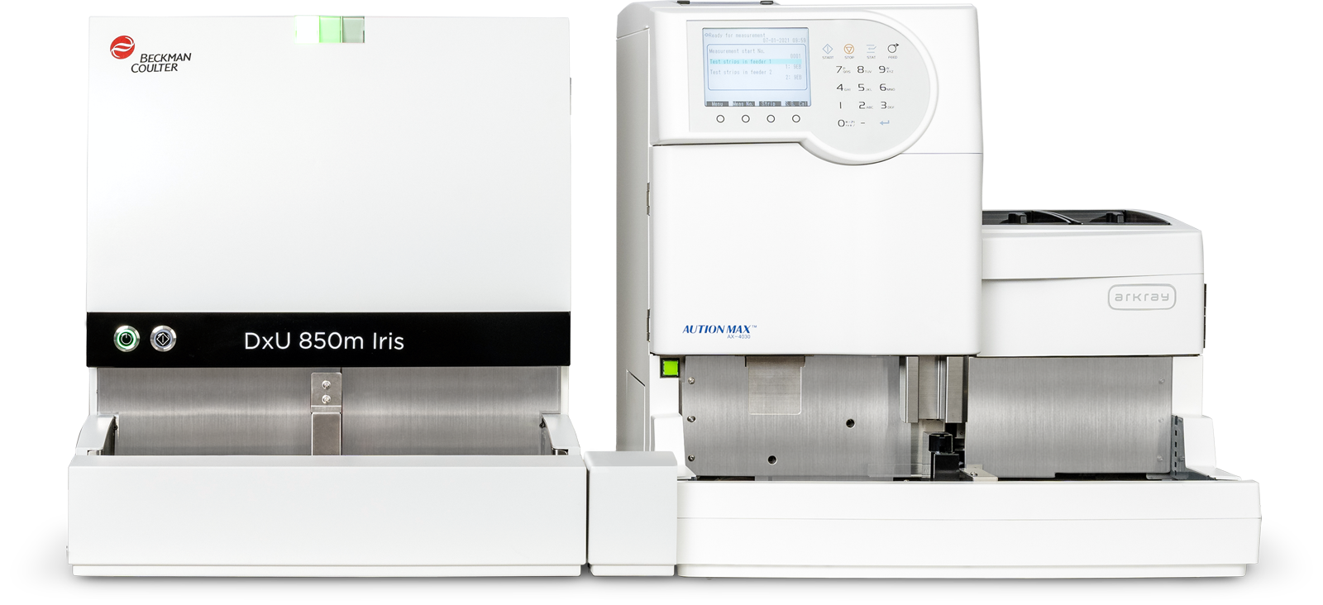




Urinalysis Case Study Book
DxU Iris Workcell Urinalysis Analyzer
Advanced Technology Casebook
© 2026 Beckman Coulter. All rights reserved. | 2025-15024

Slide 2
Disclaimer
Urinalysis Case Study Book
The DxU Iris analyzer data provided in this casebook is intended for educational purposes only and should not be used for diagnostic purposes. Further analysis is dependent on a review by a pathologist in conjunction with ancillary studies and testing for the final clinical diagnosis.
DxU Iris results included in this case study include:
Arkray Aution Max
AX-4030 Chemistry Results
DxU Iris 850m Microscopy Results
Flags
Messages
All operational and technological details for the urinalysis analyzers are described in the appropriate Instructions for Use documents, which can be located at www.beckmancoulter.com > Support > Technical Documents.

Slide 3

Patient History
Urinalysis Case Study | #1
Female, 70 years old
Female patient presented
to the ED with abdominal pain,
nausea and vomiting
She has diabetes and chronic kidney failure
She has breast cancer

Slide 4
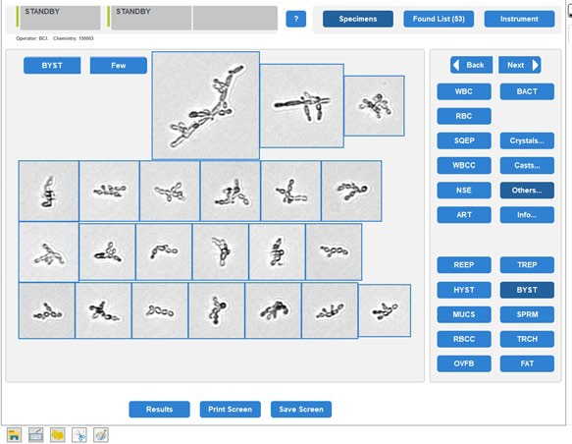
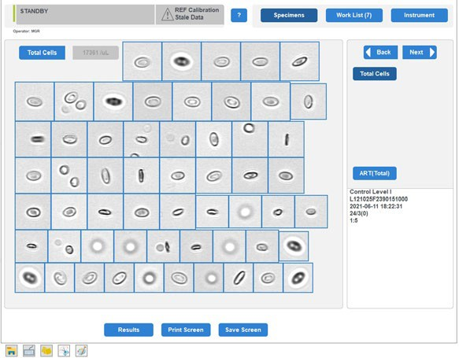
Analysis with
DxU Iris Technology
Urinalysis Case Study | #1

Slide 5


Urine Chemistry Results
Urinalysis Case Study | #1
TEST | RESULT | NORMAL VALUE* | FLAG
Glucose | 150 mg/dl | Negative | H
Protein | 70 mg/dl | Negative | H
Bilirubin | NEG | Negative
Urobilinogen | Normal | Normal
PH | 6.5 | 5.0–8.0
Blood | +2 | Negative | H
Ketone | NEG | Negative
Nitrite | NEG | Negative
Leukocytes | 500 | Negative | H
Specific Gravity | 1.019 | 1.005–1.030
Clarity | TURBID | Clear | Abnormal
Color | COLORLESS | Yellow
*User-defined Normal Values

Slide 6
Urine Microscopy Results
Urinalysis Case Study | #1
TEST | RESULT | NORMAL VALUE* | FLAGS
RBC | 20 HPF | Up to 5 | H
WBC | >182 HPF | Up to 5 | H
Bacteria | Moderate | None | H
Mucus | Rare | None | H
Squamous Epithelial Cells | 1 HPF | Up to 5
Amorphous Crystals | <MOD HPF | None | H
Additional Lab Results
Microbiology Results
SAMPLE | RESULT
Organism Group | Klebsiella spp.
Sample Type | Blood Culture
*User-defined Normal Values

Slide 7






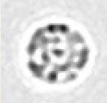






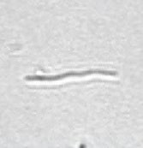


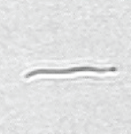
Digital Flow Microscopy
Urinalysis Case Study | #1
The following particle images have been captured
by DxUm microscopy series analyzer using digital flow imaging technology:
RBC
WBC
BACT
BACT: Bacteria

Slide 8
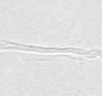
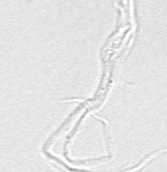
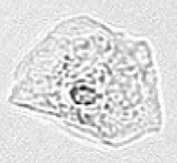
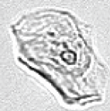
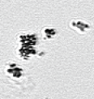
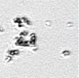
Digital Flow Microscopy
Urinalysis Case Study | #1
The following particle images have been captured
by DxUm microscopy series analyzer using digital flow imaging technology:
MUCS
SQEP
AMOR
MUCS: Mucus
SQEP: Squamous Epithelial Cells
AMOR: Amorphous Crystals

Slide 9
Acute Kidney Injury with Septic Shock
Urinalysis Case Study | #1 DIAGNOSIS
Routine urinalysis plays a critical role in early determination. When its results are combined with other tests, the monitoring of urine output and the analysis of urine composition provide rapid indicators of renal dysfunction before serum creatinine rises, thereby enabling timely intervention for Acute Kidney Injury (AKI).

Slide 10

Patient History
Urinalysis Case Study | #2
Male, 60 years old
Patient had kidney
transplantation and diagnosed as ESRD (End Stage Renal Disease)
Patient complaining of loss of appetite
and fatigue for the past week
Patient has dyspnea, hypertension
and anemia

Slide 11
Analysis with
DxU Iris Technology
Urinalysis Case Study | #2

Slide 12
Urine Chemistry Results
Urinalysis Case Study | #2
TEST | RESULT | NORMAL VALUE* | FLAG
Glucose | NEG | Negative
Protein | 50 mg/dl | Negative | H
Bilirubin | NEG | Negative
Urobilinogen | Normal | Normal
PH | 6.0 | 5.0–8.0
Blood | +1 | Negative | H
Ketone | NEG | Negative
Nitrite | +1 | Negative | H
Leukocytes | 500 | Negative | H
Specific Gravity | >1.030 | 1.005–1.030 | H
Clarity | TURBID | Clear | Abnormal
Color | Yellow | Yellow
*User-defined Normal Values

Slide 13
Urine Microscopy Results
Urinalysis Case Study | #2
TEST | RESULT | NORMAL VALUE* | FLAGS
RBC | 182 HPF | Up to 5 | H
WBC | 40 HPF | Up to 5 | H
Mucus | Rare | None | H
Squamous Epithelial Cells | 2 HPF | Up to 5
Hyaline Cast | 5 HPF | None | H
Additional Lab Results
Microbiology Results
SAMPLE | RESULT
Organism Group | Multiple Organisms (Possible Contamination)
Sample Type | Urine Culture
*User-defined Normal Values

Slide 14
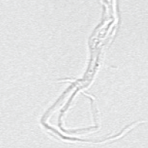
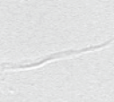
Digital Flow Microscopy
Urinalysis Case Study | #2
The following particle images have been captured
by DxUm microscopy series analyzer using digital flow imaging technology:
RBC
WBC
MUCS
MUCS: Mucus

Slide 15
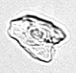
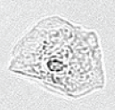
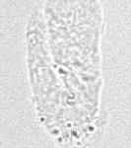

Digital Flow Microscopy
Urinalysis Case Study | #2
The following particle images have been captured
by DxUm microscopy series analyzer using digital flow imaging technology:
SQEP
HYAL
SQEP: Squamous Epithelial Cells
HYAL: Hyaline Cast

Slide 16
Urinary Tract Infection UTI
Unspecified
Urinalysis Case Study | #2 DIAGNOSIS
Routine urinalysis enables physicians to make determinations. Combined with appropriate tests and clinical context, its results significantly aid diagnosis, leading to quicker, targeted treatment that reduces discomfort, prevents complications, and promotes responsible antibiotic use.

Slide 17

Patient History
Urinalysis Case Study | #3
Male, 80 years old
Patient complaining
about abdominal distention
and loss of appetite
Patient has Uremia
and Urinary Tract Obstruction
Patient diagnosed
with Chronic Renal Failure

Slide 18
Analysis with
DxU Iris Technology
Urinalysis Case Study | #3

Slide 19
Urine Chemistry Results
Urinalysis Case Study | #3
TEST | RESULT | NORMAL VALUE* | FLAG
Glucose | NEG | Negative
Protein | 70 mg/dl | Negative | H
Bilirubin | NEG | Negative
Urobilinogen | Normal | Normal
PH | 7.5 | 5.0–8.0
Blood | +3 | Negative | H
Ketone | NEG | Negative
Nitrite | NEG | Negative
Leukocytes | 500 | Negative | H
Specific Gravity | 1.013 | 1.005–1.030
Clarity | Extra Turbid | Clear | Abnormal
Color | Orange | Yellow
*User-defined Normal Values

Slide 20
Urine Microscopy Results
Urinalysis Case Study | #3
TEST | RESULT | NORMAL VALUE* | FLAGS
RBC | 26 HPF | Up to 5 | H
WBC | >182 HPF | Up to 5 | H
WBC Clump | Few | None | H
Bacteria | Many | None | H
Mucus | Moderate | None | H
Squamous Epithelial Cells | 1 HPF | Up to 5
Additional Lab Results
Microbiology Results
SAMPLE | RESULT
Organism Group | Proteusmirabilis
Sample Type | Urine Culture
*User-defined Normal Values

Slide 21



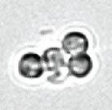
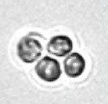
Digital Flow Microscopy
Urinalysis Case Study | #3
The following particle images have been captured
by DxUm microscopy series analyzer using digital flow imaging technology:
RBC
WBC
WBCC
WBCC: WBC Clump

Slide 22


Digital Flow Microscopy
Urinalysis Case Study | #3
The following particle images have been captured
by DxUm microscopy series analyzer using digital flow imaging technology:
BACT
SQEP
MUCS
BACT: Bacteria
SQEP: Squamous Epithelial Cells
MUCS: Mucus

Slide 23
Urinary Tract Obstruction with Chronic Kidney Failure
Urinalysis Case Study | #3 DIAGNOSIS
Routine urinalysis enables physicians to make determinations. Confirmation of urinary tract obstruction with chronic kidney failure is typically achieved through imaging studies such as a renal ultrasound or CT scan to visualize structural blockage. However, urinalysis is essential in supporting this process by detecting abnormalities such as hematuria, proteinuria, and crystalluria, which indicate impaired renal function and possible obstruction, guiding the need for these confirmatory imaging studies.

Slide 24

Patient History
Urinalysis Case Study | #4
Male, 65 years old
Patient presented
to ER with hematuria
The patient was admitted and discharged with a Foley catheter due to urinary retention, a catheter was exchanged,
and the patient had difficulty urinating
Patient was having abdominal pain due
to urinary retention

Slide 25
Analysis with
DxU Iris Technology
Urinalysis Case Study | #4

Slide 26
Urine Chemistry Results
Urinalysis Case Study | #4
TEST | RESULT | NORMAL VALUE* | FLAG
Glucose | >1000 mg/dl | Negative
Protein | 50 mg/dl | Negative | H
Bilirubin | NEG | Negative
Urobilinogen | Normal | Normal
PH | 6.5 | 5.0–8.0
Blood | +3 | Negative | H
Ketone | NEG | Negative
Nitrite | +1 | Negative
Leukocytes | 500 | Negative | H
Specific Gravity | 1.016 | 1.005–1.030
Clarity | Extra Turbid | Clear | Abnormal
Color | Orange | Yellow
*User-defined Normal Values

Slide 27
Urine Microscopy Results
Urinalysis Case Study | #4
TEST | RESULT | NORMAL VALUE* | FLAGS
RBC | 1 HPF | Up to 5
WBC | 174 HPF | Up to 5 | H
Bacteria | Moderate | None | H
Mucus | Moderate | None | H
Squamous Epithelial Cells | 90 HPF | Up to 5
Additional Lab Results
Microbiology Results
SAMPLE | RESULT
Organism Group | Escherichia coli (ESBL)
Sample Type | Urine Culture
*User-defined Normal Values

Slide 28
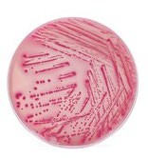
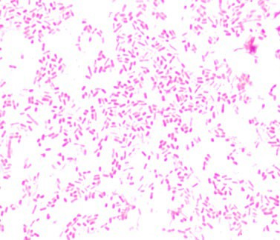
Urine Microscopy Results
Urinalysis Case Study | #4
Additional Lab Results
Microbiology Results
SAMPLE | RESULT
Organism Group | Gram Negative Bacilli
Organism | E.Coli
Colony Count | >100,000 CFU/mL
Gram Stain | Gram-negative Bacilli Seen

Slide 29






Digital Flow Microscopy
Urinalysis Case Study | #4
The following particle images have been captured
by DxUm microscopy series analyzer using digital flow imaging technology:
RBC
WBC
SQEP
SQEP: Squamous Epithelial Cells

Slide 30
Digital Flow Microscopy
Urinalysis Case Study | #4
The following particle images have been captured
by DxUm microscopy series analyzer using digital flow imaging technology:
BACT
BACT: Bacteria

Slide 31
Urinary Tract Infection UTI
E. Coli, ESβL
Urinalysis Case Study | #4 DIAGNOSIS
Routine urinalysis enables physicians to make determinations. Combined with appropriate tests and clinical context, its results significantly aid diagnosis, leading to quicker, targeted treatment that reduces discomfort, prevents complications, and promotes responsible antibiotic use.

